Slide 1
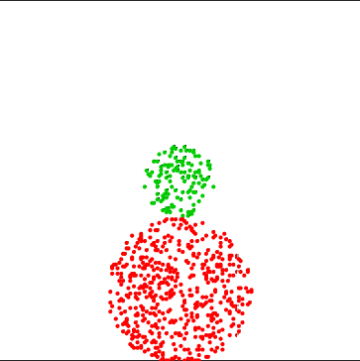
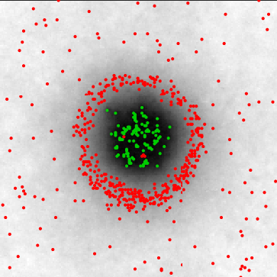
Fig. S1 - Model 1 – kinetic segregation (KS) – Physical model + InterCells
A
Physical model
T-cell
i,j
CD45
TCR
Δz_{i,j}
pMHC
APC
B
Interactions
C
T-cell (initial)
D
T-cell (final)
Δz(nm)
2000
70 nm
50
40
Attraction
Repulsion
1000
30
Y(nm)
20
10
t = 0
t = 100sec
0 nm
0
0
2000
0
K_{B}T
0
1000
0
1000
2000
X(nm)
X(nm)

Slide 2
Fig. S1 - Model 1 – kinetic segregation (KS) – Physical model + InterCells
A
Physical model
T-cell
i,j
Δz_{i,j}
TCR
CD45
pMHC
APC
i,j
B
Interactions
C
T-cell (initial)
D
T-cell (final)
nm
2000
70 nm
50
40
Attraction
Repulsion
30
1000
Y(nm)
20
10
t = 0
t = 100sec
0 nm
0
0
2000
0
K_{B}T
0
1000
0
1000
2000
X(nm)
X(nm)

Slide 3
Fig. S1 - Model 1 – kinetic segregation (KS) – Physical model + InterCells
Physical model
Interactions
A
B
50
TCR
40
CD45
30
20
pMHC
10
0
K_{B}T
2000
T-cell (initial)
T-cell (final)
70 nm
C
D
1000
Y(nm)
0
t = 0
2000
t = 100sec
0 nm
0
1000
0
1000
2000
X(nm)
X(nm)

